Slide 1
Model 6 Introduction to Network Security
Lesson 1: Network basics and threats

Slide 2
Module 6: Introduction to Network Security
Module Description:
This module introduces network security. In the first micro module, students will be given an overview of networks, and then move to network attacks, such as Denial-of-service attacks. The second micro module discusses network encryption and some network protocols, such as IPV6, SSH, SSL/TLS, HTTPS, IPSec. Network defense techniques are introduced in the third micro module. This micro module focuses on techniques such as firewalls, intrusion detection and prevention systems, honeypot.
Topics:
Lesson 1: Network basics and threats
Lesson 2: Network encryption and protocols
Lesson 3: Network defense technologies

Slide 3
Lesson 1: Network basics and threats
Topics:
Basics of network (OSI model, DoD TCP/IP model)
Network attacks
Denial-of-Service attacks
Distributed Denial-of-Service attacks
Zombies and Botnets
Learning Outcomes:
Upon completion of this lesson:
Students will be able to understand network basics.
Students will be able to describe Denial-of-Service attacks.
Students will be able to explain Distributed DoS attacks.
Students will be able to define Zombies and Botnets.

Slide 4
Objectives for Chapter 6
This lecture:
Networking basics
Network threats and vulnerabilities
WiFi security
Denial-of-service attacks
Next lecture:
Network encryption concepts and tools
Types of firewalls and what they do
Intrusion detection and prevention systems
Security information and event management tools

Slide 5
Warm Up: Network basics
Network - Information system(s) implemented with a collection of interconnected components.
A component can be a computer, printer, or any other device capable of sending and/or receiving data generated by other components on the network.
Interconnect link: can be a cable, air, optical fiber, or any medium which can transport a signal carrying information.

Slide 6
Background
How do data networks work?
Systems communicate over a shared communication medium according to an agreed upon convention (standard).
Several sets of standards currently exist:
DoD: TCP/IP
ISO: OSI model
Commercial: SNA, IPX, X.25, ...
Proprietary
In this course we will basically follow the seven layer approach defined by ISO with additional emphasis on the DoD hierarchy.

Slide 7
Network Transmission Media
Data travels either on wire or wirelessly, both of which are vulnerable.
Cable
Optical fiber
Microwave
WiFi
Satellite communication
When data leave the protected environment, others along the way can view or intercept the data:
eavesdrop
wiretap
sniff

Slide 8
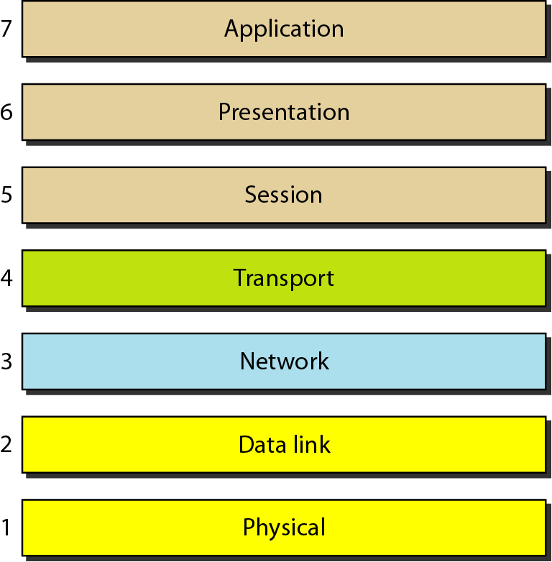
ISO/OSI model
An ISO (International Standards Organization) standard that covers all aspects of network communications is the Open Systems Interconnection (OSI) model.
First introduced in late 1970s.

Slide 9
TCP/IP Protocol suite
Transmission Control Protocol/Internet Protocol, is a suite of communication protocols used to interconnect network devices on the internet.
Application layer: SMTP, HTTP, FTP, etc
Transport layer: TCP, UDP
Network layer: IP, ICMP, IGMP
Data link layer: Device drivers
Physical Layer: Network Adapters

Slide 10
Transmission Control Protocol (TCP)
Connection oriented
Explicit set-up and tear-down of TCP session
Reliable, in-order delivery
Checksums to detect corrupted data
Acknowledgments & retransmissions for reliable delivery
Sequence numbers to detect losses and reorder data
Flow control
Prevent overflow of the receiver’s buffer space

Slide 11
User Datagram Protocol (UDP)
User Datagram Protocol (UDP)
IP plus port numbers to support (de)multiplexing
Optional error checking on the packet contents
No delay for connection establishment
UDP just blasts away without any formal preliminaries
Unreliable Message Delivery service
Good for multimedia streaming

Slide 12
Internet Control Message Protocol (ICMP)
Internet Control Message Protocol (ICMP) is a supporting protocol in the Internet protocol suite.
It is used by network devices, such as routers, to send error messages and operational information.
Ping is a computer network administration software utility used to test the reachability of a host on the network.
Ping sends ICMP Echo Request packets to the target host and waiting for an ICMP Echo Reply.
The program reports errors, packet loss, and a statistical summary of the results.

Slide 13
ICMP
ICMP protocols include:
ping, which requests a destination to return a reply, intended to show that the destination system is reachable and functioning.
echo, which requests a destination to return the data sent to it, intended to show that the connection link is reliable (ping is actually a version of echo).
destination unreachable, which indicates that a destination address cannot be accessed.
source quench, which means that the destination is becoming saturated and the source should suspend sending packets for a while.

Slide 14
Denial of Service (DoS)
DoS - The prevention of authorized access to resources or the delaying of time-critical operations. (Time-critical may be milliseconds or it may be hours, depending upon the service provided.)
Denial of service ranges from complete loss of access to unacceptable slowing of service.
The source of a denial-of-service attack is typically difficult to determine.

Slide 15
DoS attack: Ping of Death
In ping of death attack, a flood of ping commands will be sent to the victim.
Ping required the recipient to respond to the packet.
If the victim has smaller bandwidth, the response to the flood of ping commands may exhaust the victim’s bandwidth.

Slide 16
DoS attack: smurf
In a smurf attack, ICMP echo request packets will be sent to the broadcast address of a target network, with the IP address spoofed to be the victim’s IP address.
All the response to the ICMP echo request will be sent to the victim, therefore the victim will be saturated with the replies from the entire network.

Slide 17
DoS attack: SYN flood
In SYN flood attack, TCP packets with a spoofed source IP address request a connection (starts a 3-way handshake) to the victim’s network.
The victim’s network responds with a SYN-ACK packet, but there will be no response to the SYN-ACK packet because of the spoofed source IP address. However the victim will waiting for the completion of the TCP three-way handshake.
If many SYN packets with spoofed source IP address sent to the victim, the connections can quickly overwhelm the victim’s system resources, which may cause system crash or unusable.

Slide 18
DoS Attack: DNS Spoofing
A domain name server (DNS) is a table that converts domain names like website.com into network addresses like 211.217.74.130; this process is called resolving the domain name.
Any server can respond to a DNS lookup request, and the first one to respond wins.
In DNS spoofing attack, the attacker acts as the DNS server and quickly respond to a DNS lookup request with a attacker’s network address. Therefore redirect the user to malicious sites.

Slide 19
Distributed Denial of Service (DDoS)
Distributed Denial of Service (DDoS) - A Denial of Service technique that uses numerous hosts to perform the attack.
To perform a distributed denial-of-service (or DDoS) attack, an attacker needs to do:
Plant a Trojan horse on a target machine, and repeat this process with many targets. These targets are called zombies.
If a victim is chosen, the attacker sends a signal to all the zombies, and the zombies will launch the attack to the victim.

Slide 20
Bots & Botnets
Zombie/bot - A compromised computer under the control of an attacker.
Bot code, a malware installed on the compromised computer to communicates with the attacker’s server and perform the malicious activities.
Botnets, a networks of bots controlled by an attacker to perform malicious activities.
Botnets are often used to execute DDoS attacks.

Slide 21
Botnets command-and-control
People who infect machines to turn them into bots are called botmasters.
The botmaster is called a command-and-control center. It control the individual bots, sends commands to the bots, such as when to start/stop and attack against which victim.
Communication from the command-and-control center to the bots can be pushed, or pulled.
Pushed – the command-and-control center sending instructions to the bots
Pulled – each bot periodically check with the command-and-control center to see if there is work to do or not.

Slide 22
Active Learning Activity:
In-class discussion:
What problems can Denial-of-Service attacks bring? How to avoid being attacked?

Slide 23
Summary
Topics:
Basics of network (OSI model, DoD TCP/IP model)
Network attacks
Denial-of-Service attacks
Distributed Denial-of-Service attacks
Zombies and Botnets

Slide 24
Please attribute Dr. Jim Alves-Foss and Dr. Jia Song, University of Idaho
Except where otherwise noted, this work is licensed under https://creativecommons.org/licenses/by-nc-sa/4.0/ Not withstanding the non-commercial license terms, non-profit educational institutions are granted a non-exclusive license to adapt and use this material, with attribution. Creative Commons and the double C in a circle are registered trademarks of Creative commons in the United States and other countries. Third party marks and brands are the property of their respective holders.
Project sponsored by the National Security Agency under grant Number H98230-17-1-0199. The United States Government is authorized to reproduce and distribute reprints notwithstanding any copyright notation herein.

